Slide 1
A distributed billion-row spreadsheet
Mihai Budiu - VMware Research
University of Edinburgh, Sept 13, 2016
Joint work with Rebecca Isaacs, Derek Murray, Gordon Plotkin, Paul Barham, Samer Al-Kiswany, Yazan Boshmaf, Qingzhou Luo, Alexandr Andoni
Work done at Microsoft Research, Silicon Valley https://youtu.be/NkV5r7OzCoc

Slide 2
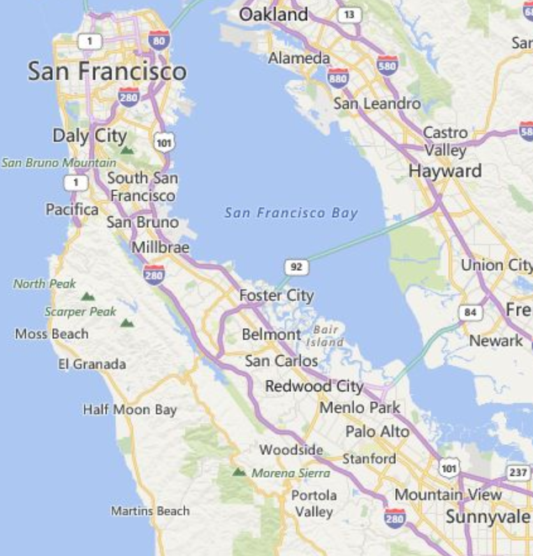
VMware Research Group (VRG)
http://research.vmware.com
Founded in December 2014
Headed by David Tennenhouse, Chief Research Officer
Two labs:
Palo Alto, CA: 8 researchers, 3 post-docs, 2 part-time, 12 interns in 2016
Israel: 2 researchers, 1 post-doc
(Distributed) systems research:
Non-volatile memory, operating systems, consensus, fault-tolerance, blockchain, networking, storage, concurrency, compilers, FPGAs, large scale computation, GPU computing, algorithms
Mission: Advance state-of-the-art, improve VMware products
Currently expanding

Slide 3



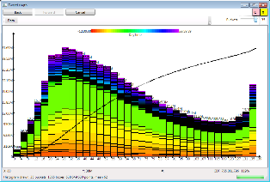
Spreadsheet Motivation
Work on large-scale computation engines (> 10⁵ computers)
Analyze large logs and/or large datasets
Problem: browse 10⁹ data points using 10⁶ pixels
Do it interactively

Slide 4

Sketch = parallelization library
Sketch library handles all distributed system aspects
Network communication
Parallelization across machines and cores
Fault tolerance
Straggler avoidance
Distributed garbage-collection
3 applications
Billion-row spreadsheet
Performance analyzer
Distributed log browser

Slide 5

Outline
Visualization principles for large data
The Sketch library
A billion-row spreadsheet
Other applications
Conclusion

Slide 6


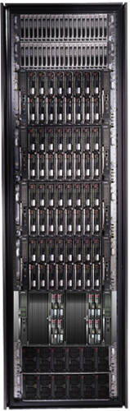
Bandwidth hierarchy

Slide 7

Principles
Visualizations are bounded data displays
We cannot show all data
Do not compute views with resolution exceeding screen resolution
Tools must run at interactive speeds

Slide 8

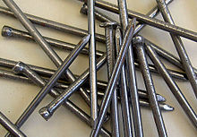
Aggregation
Visualizations = aggregates
Sketch = a system which can ONLY compute aggregates
Try to express data visualization only using aggregates
“If all you have is a hammer, everything looks like a nail”
Maslow’s law

Slide 9

Aggregations = streaming algorithms
Multi-pass, randomized streaming algorithms
Sublinear memory
Insensitive to input order
Naturally parallelizable
Data never moves
Low network bandwidth required

Slide 10

Monoids
A set M
An operation + : M x M -> M
A distinguished zero element: a + 0 = 0 + a = a
Commutative if a + b = b + a
Lots of interesting monoids
Reals with addition, min, max
Strings with concatenation
Sets and multisets with union and intersection
Dictionaries over monoids M[K] (finite maps K -> M)
Vectors, matrices with monoid values
And compositions of the above
More monoids will appear during the presentation

Slide 11

Linear transformations
Linear functions between monoids: f: M → N, f(a + b) = f(a) + f(b)
“Map” and “reduce” are linear functions
Linear transformations are the essence of data parallelism
Many streaming algorithms are linear transformations

Slide 12
Architecture
Applications
User interface
Streaming algorithms
Sketch framework
Library for linear transformations
Immutable, distributed, garbage-collected objects

Slide 13
Outline
Visualization principles for large data
The Sketch library
A billion-row spreadsheet
Other applications
Conclusion

Slide 14
Distributed visualization applications
User
User
View
View
Sketch
Data model
Network
Sketch
Sketch
Data model
Data model
Single machine
Distributed system

Slide 15


Sketch distributed service
Sketch
service
Sketch
service
Sketch
service
Sketch
service
data
data
data
data

Slide 16
DataSets = immutable distributed objects
Client
Application
DataSet<T>
Network
Servers
T
T
T
T
T
T
T
T
T
T
T
16

Slide 17
DataSet Core API
interface IDataSet<T> { IDataSet<S> Map<S>(IMap<T,S> f); IDataSet<Pair<T,S>> Zip(IDataSet<S> other); R Sketch(ISketch<T, R> sk); }
interface IMap<T,S> { S Map(T data); }
interface ISketch<T,R> { R Create(T data); R Combine(List<R> parts); }
Serializable closures
(client => server)
Serializable datatype
(server => client)

Slide 18
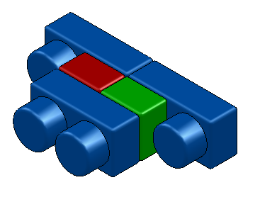
Dataset objects
Implement IDataSet<T>
Identical interfaces on top and bottom
Can be stacked arbitrarily
Modular construction of distributed systems
IDataset
interface

Slide 19
LocalDataset<T>
Contains a reference to an object of type T in the same address space
Directly executes operations (Map, Sketch, Zip) on object
Local
T

Slide 20
ParallelDataset<T>
Has a number of children of type IDataSet<T>
Executes operations on all children concurrently
Sketch combines the result of sketches on all children
The only component that deals with concurrency!
No locks anywhere in the code!
Parallel

Slide 21
ProxyDataset<T>
Has a reference to IDataSet<T> in another address space
The only component that deals with the network!
RMI layer on top of Windows Communication Foundation
Proxy keeps a lease to remote objects
Periodic keep-alives from clients to server
Leases are reference-counted at server
When all leases expire remote reference is GC-ed
Distributed GC for free!
Client
Proxy
ref
RMI
Server

Slide 22
ReplicatedDataset<T>
All children must represent the same data
Ideally in separate fault domains
If a child throws an exception (but not the other children) it is marked as in invalid
The only fault-tolerance mechanism!
Replicated

Slide 23
HedgedDataset<T>
A cross between Parallel and Replicated
Runs operation on all children concurrently
Returns the first result that is received
Useful for straggler avoidance
Hedged

Slide 24
LazyDataset<T>
Delegates Sketch operations to children
Returns immediately for Map and Zip
Composes outstanding operations
Batch execution of operations
Algebra:
IMap o IMap = IMap
IMap o ISketch = ISketch
Lazy

Slide 25
A distributed dataset
Address space
Application
GUI
Client
Cluster parallelism
Parallel
Proxy
Proxy
RMI layer
Network
Server 0
ref
Server 1
ref
ref
Server n
Parallel
Rack aggregation
Parallel
Proxy
Parallel
Core parallelism
Parallel
Local
Local
Local
Local
Local
Local
T
T
Rack 0
T
T
T
T
Rack r

Slide 26
Map(f)
Proxy
Proxy
Parallel
Parallel
Local
Local
Local
Local
T
T
S
S
f
f

Slide 27
Sketch(s)
interface ISketch<T,R> { R Create(T data); R Combine(List<R> parts); }
R
Proxy
s.Combine
R
Parallel
R
R
Local
Local
s.Create
T
T

Slide 28
Zip
Proxy
Proxy
Proxy
Parallel
Parallel
Parallel
Local
Local
Local
Local
Local
Local
T
T
S
S
T,S
T,S

Slide 29
Exceptions
Client
Application
X
X
Any exception propagates back up to the client
Including through RMI/proxy
Client sees an exception in its local address space
Even if exception happens remotely
All dataset operations are atomic!
They commit when client gets back reference
Dangling partial Datasets are GC-ed
No leaks
Proxy
X
Parallel
Local
Local
S
S

Slide 30
Bootstrapping
Client knows the cluster topology
Client creates init, a Dataset<Empty>
Shape chosen by client
init sends keep-alives periodically
init can be used to load data
Using a Map(loadFile)
loadFile : IMap<Empty, Data>
Parallel
Proxy
Proxy
Sketch
service
Sketch
service
Parallel
Parallel
Local
Local
Local
Local
data
data
Rack r

Slide 31

Other DataSet API features
Asynchronous computation
Using .Net async/await
Background operation cancellation
Progress reporting
Necessary for writing responsive applications
History and lineage are built-in

Slide 32
Outline
Visualization principles for large data
The Sketch library
A billion-row spreadsheet
Other applications
Conclusion

Slide 33
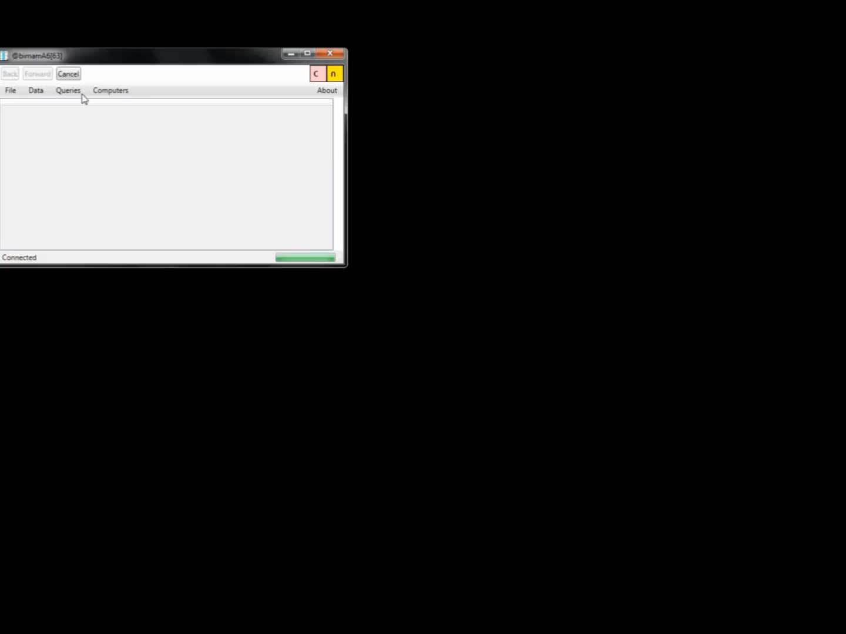

Slide 34
Sketch Spreadsheet architecture
GUI
Spreadsheet display
DataSet<Table>
Distributed objects
Table operations
Spreadsheet logic
SQL Server
CSV Files
Column store
Cosmos
Storage layer

Slide 35
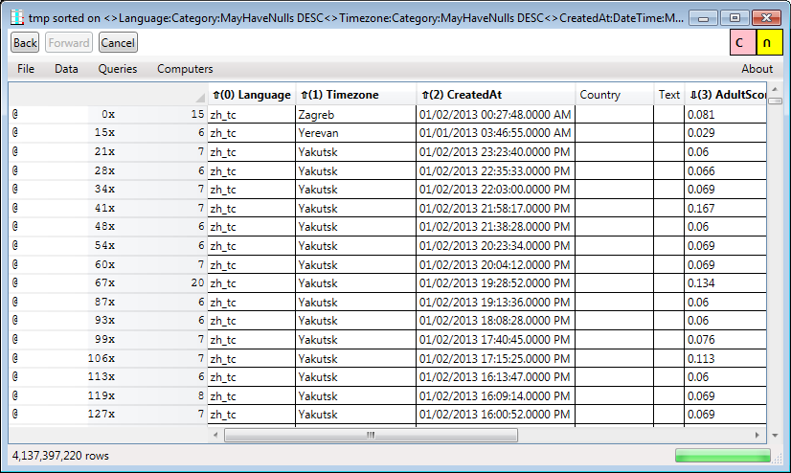
Spreadsheet operations
Browsing/scrolling
Filtering
Using predicates
Heavy hitters
Sampling
Searching
Sorting
Computing new columns
Set operations (intersection, union, etc.)
Charting

Slide 36
4 billion rows on 155 machines
Visible columns
Row header
Sorting order
Hidden columns
Row Scroll-bar
Position
Count
NextK sketch
Dataset size
Column scroll-bar

Slide 37
NextK and Scrolling
NextK(startTuple, sortOrder, K)
Streaming algorithm
Commutative monoid over a set of K tuples
Monoid operation is “merge sort”
Scrolling
Compute startTuple based on scroll-bar position
Approximate quantile
Run NextK

Slide 38

Histograms
CDF
2D
histogram
Histograms are monoids.
Sample data to make error bars smaller than 1 pixel =>
no visible information loss.

Slide 39
Histogram execution timeline
User click
t_{a}
t_{r}
Quantize
t_{h}
Render
Completed
Client
Histogram
+ CDF
concurrent
sketch
Data range
sketch
Server 1
Server n
Compute

Slide 40
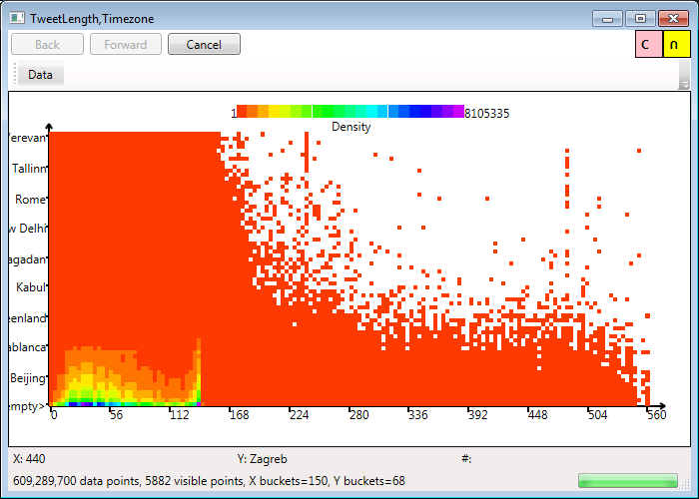
Heat Maps
Heatmaps are 2D histograms.

Slide 41
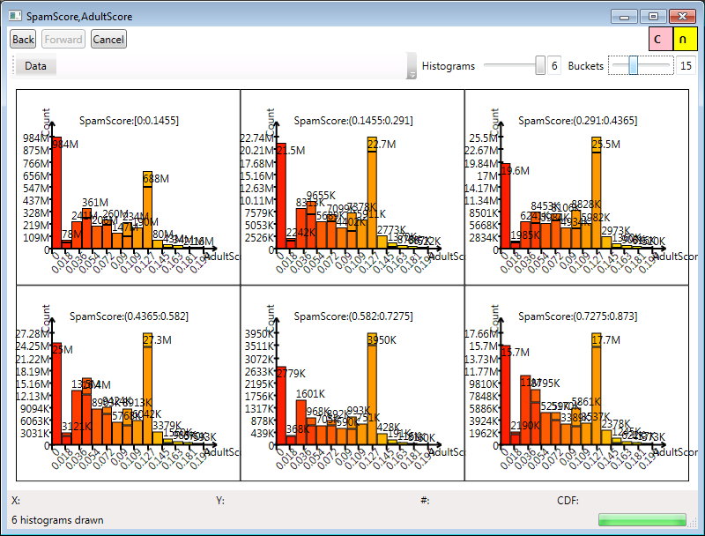
Multi-dimensional histograms

Slide 42
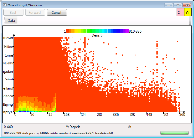
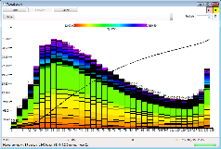
The back button
view
view
back
view
back
Render
Render
Render
Sketch
Sketch
Sketch
Sketch
init
Map (load)
data
Map
data
Zip
data
Lineage
(serializable)
Map
data
Sketch
view

Slide 43

Test platform
155 (old) machines, AMD Opteron 2373 EE, 2.1GHz
8 cores/machine, 1240 cores total
Windows Server 2012 R2
Data: 3 1TB disks striped (RAID 0)
16GB RAM/machine
1Gbps Ethernet everywhere

Slide 44
Scale-out experiment (constant data/machine)
Time (ms)
(a)
(b)
(c)
Machines
4.4B rows
COST (Cost Of Single-Threaded implementation): 1.35 (i.e., 35% overhead)

Slide 45
Outline
Visualization principles for large data
The Sketch library
A billion-row spreadsheet
Other applications
Conclusion

Slide 46
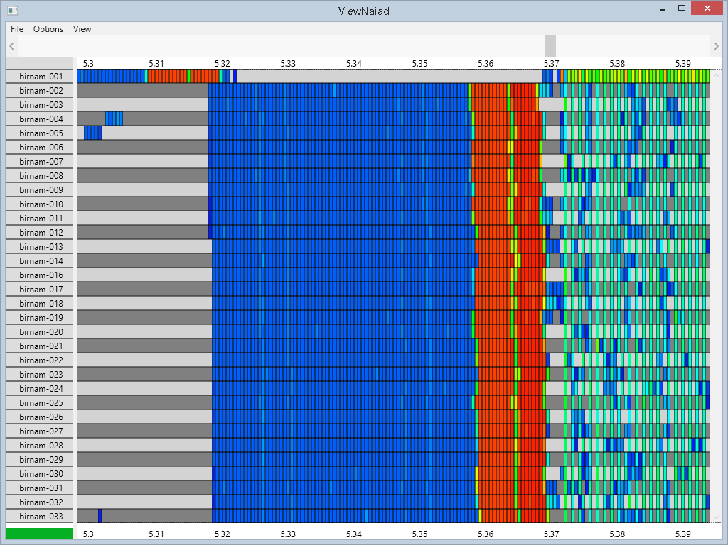
ClusterViewer: Performance Debugger
Ported to run on top of Sketch in 1 person-week (single machine => distributed execution).

Slide 47
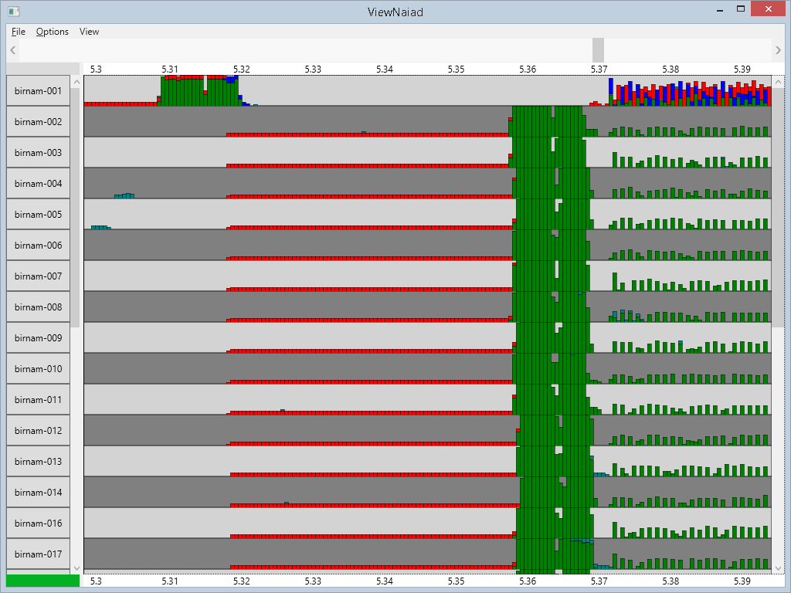
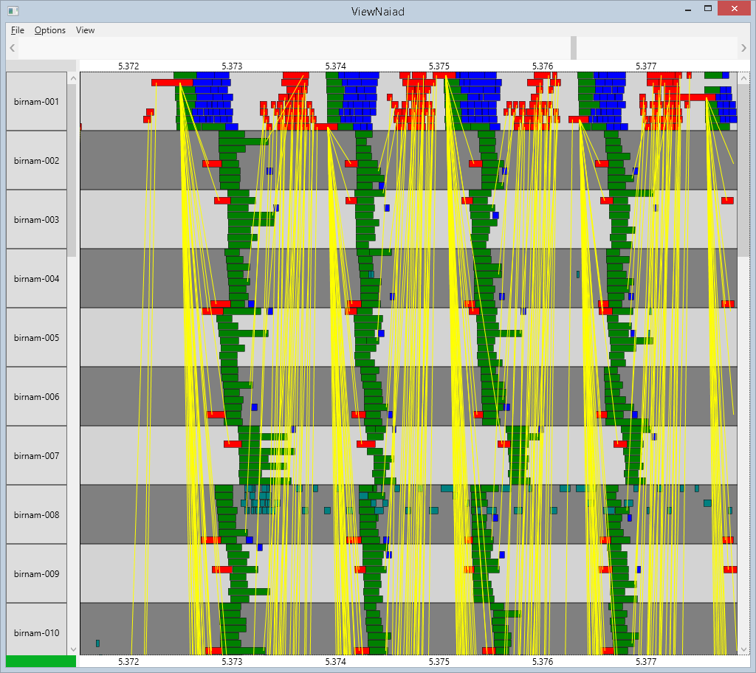
Zooming-In
Time
Scroll-bars
Machine
CPU usage
Network messages
8 cores

Slide 48
A log browser
Segmented logs: time-based indexing
Reuses Spreadsheet GUI
Spreadsheet
DataSet<Table>
Log parser
Distributed logs

Slide 49

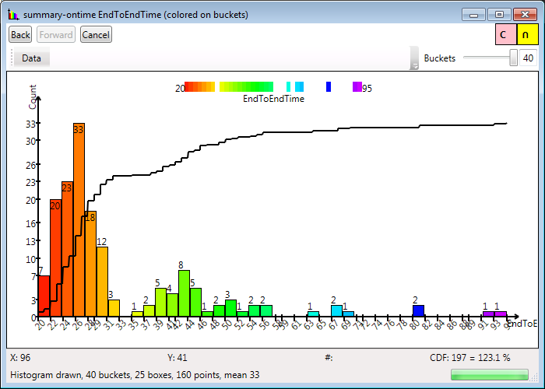
Self-debugging
Sketch
service
Sketch
service
Sketch
service
DataSet<Log>
logs
logs
logs
Map(logParser)
DataSet<Table>
End-to-end time distribution, query “FlightDate”, 155 machines

Slide 50

Conclusions
Distributed systems from Lego-like blocks
Identical interfaces on top and bottom
Sketch = a language of linear transformations
Sketching/streaming algorithms = efficient and parallelizable
Visualization recast as a sketching

